Slide 1
Identifying YouTube Videos “Made for Kids”
Sue Lim
July 23, 2023
Notes:
1. Today, I am going to discuss a project involving a machine learning model which identifies kids videos on YouTube.
2. Kids videos are important sources of business for YouTube.
3. YouTube tracks and requires uploaders to specify if a video is made for kids or not

Slide 2
I. Project background

Slide 3
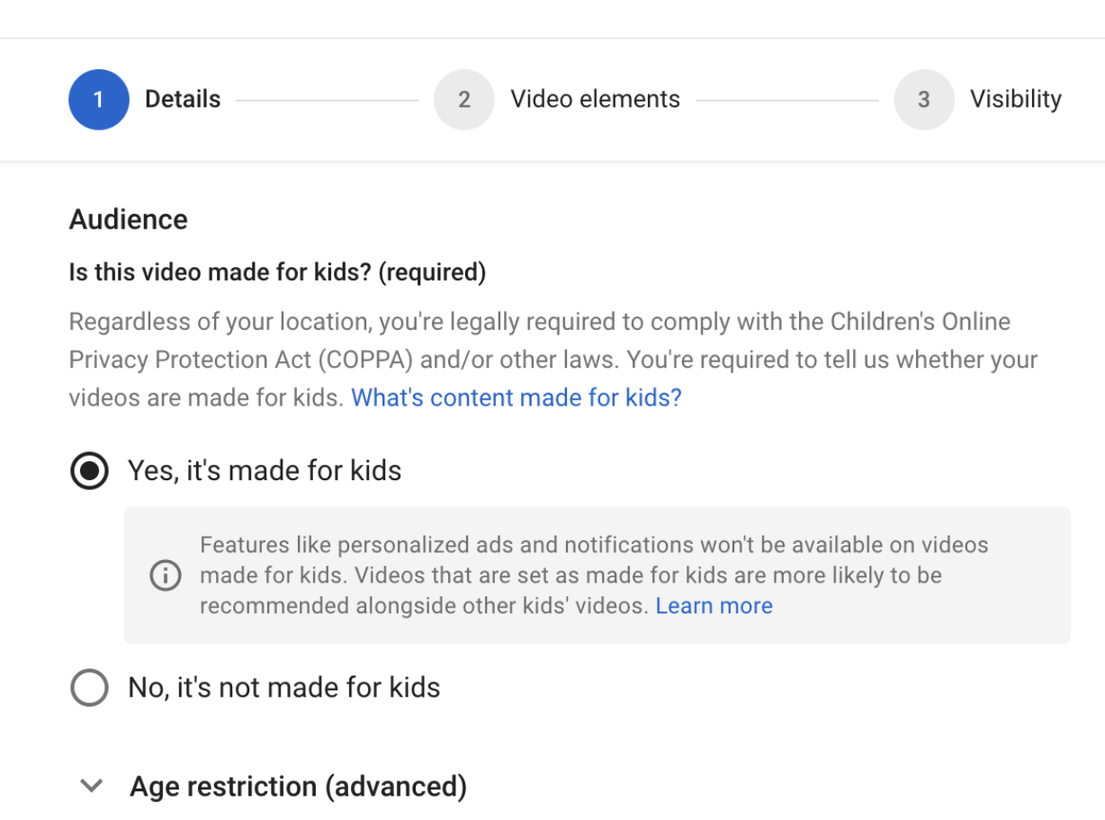
Overview
Main Model
Conclusion
YouTube Videos “Made for Kids”
FTC requires identifying YouTube videos “made for kids” under COPPA (Children’s Online Privacy Protection Act)
Such videos are under certain restrictions
YouTube may face legal consequences if content is not categorized correctly
The need to flag videos correctly
Notes:
Why does YouTube track and identify videos “made for kids”?
--- Slide ---
It is important to flag videos correctly, and that is the value and the motivation behind this project.

Slide 4
Overview
Main Model
Conclusion
Recommendation
Use a Naïve Bayes model
It has high prediction accuracy
The model can save manual human efforts in identifying videos “made for kids”
Notes:
To conclude, the Naïve Bayes model has prediction accuracy high enough to be used for practical purposes,
and employing such model is going to save a lot of human efforts to review individual videos.

Slide 5
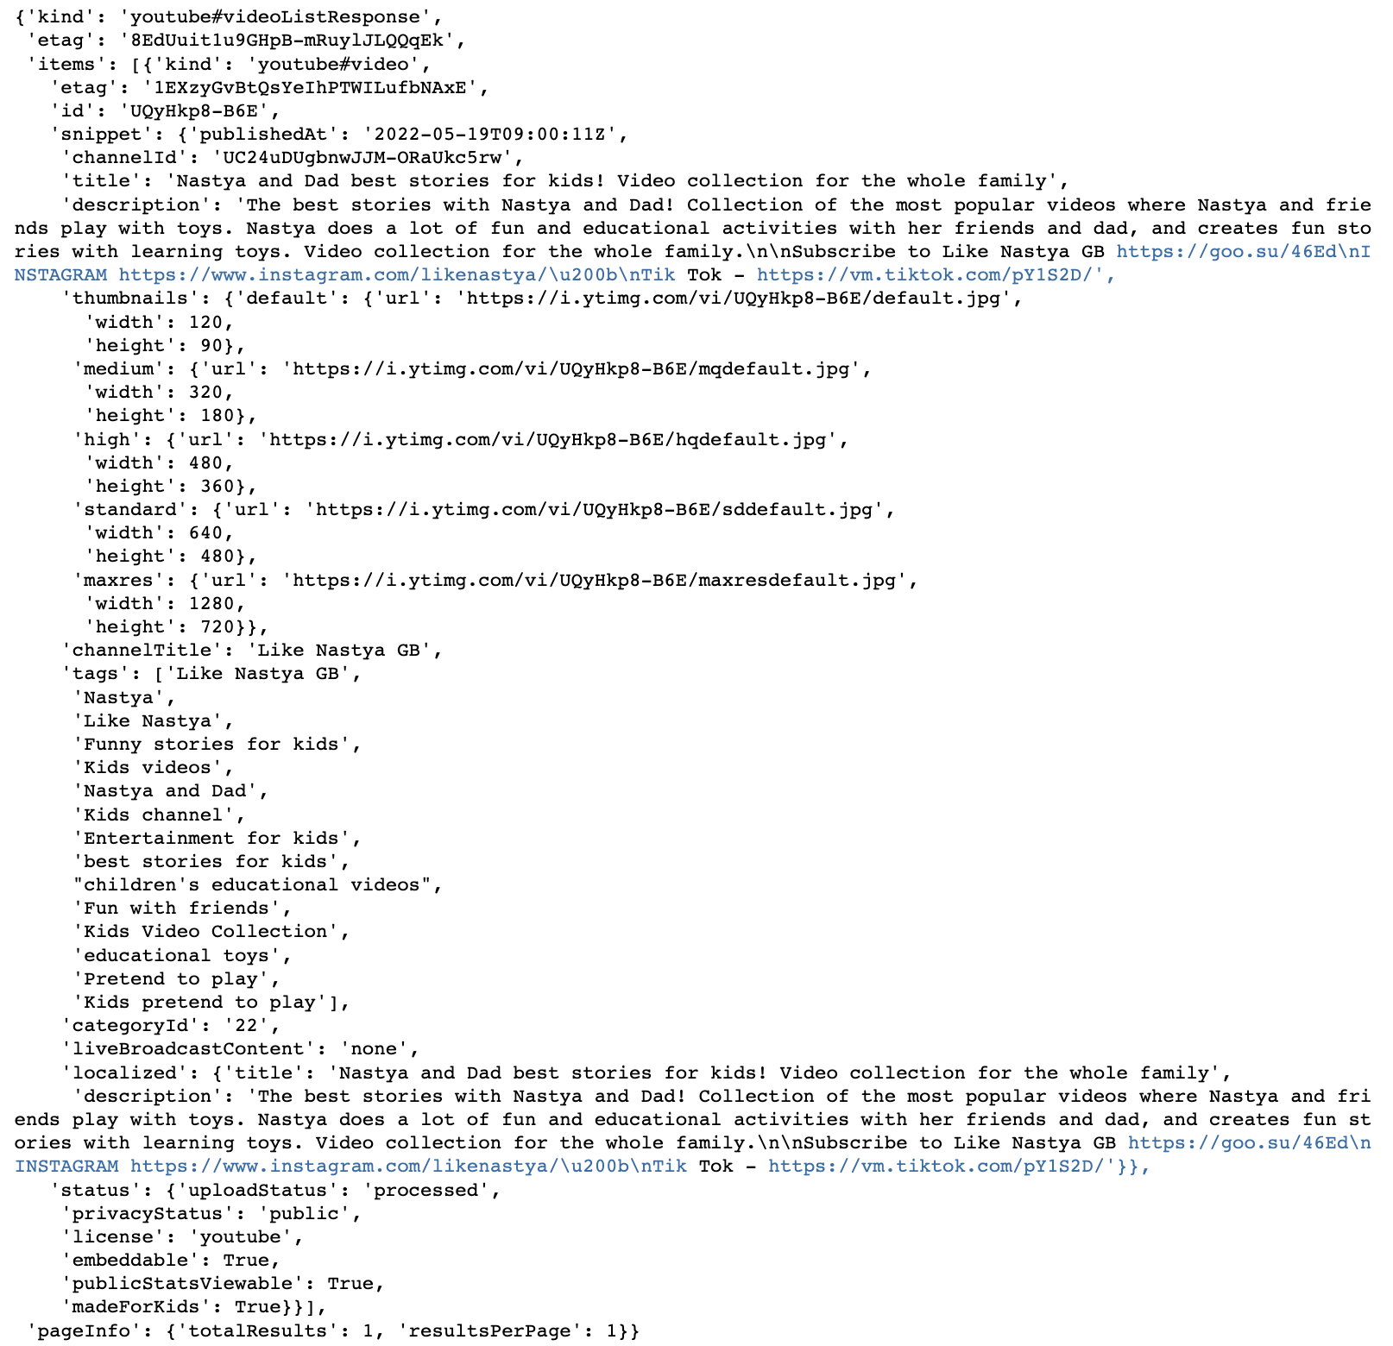
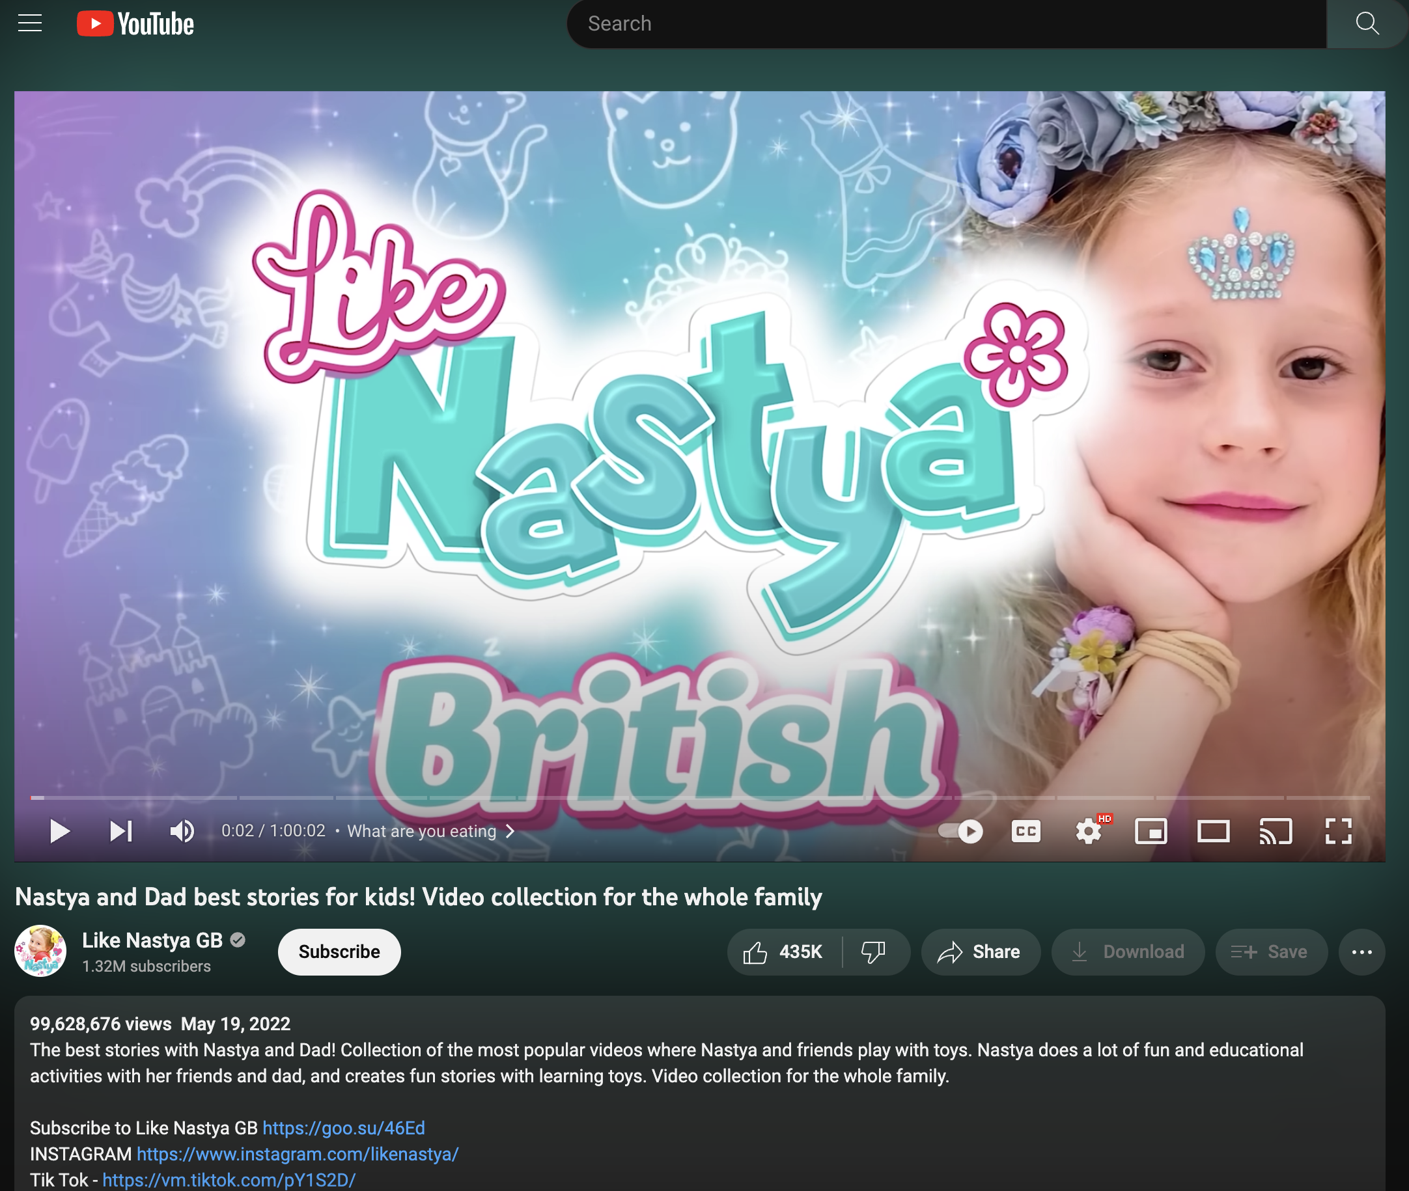
Overview
Main Model
Conclusion
YouTube API Data
Notes:
Let me talk about the data used for this project for a moment.
YouTube provides their data through API and there are various fields.
Example

Slide 6
Overview
Main Model
Conclusion
Benefits of Machine Learning
Highly scalable
Reduce manual human efforts
Consistent criteria in identifying videos
Notes:
And I use a machine learning model for this flagging task for a few following reasons.
---Slide---

Slide 7
Ii. Main model
Notes:
And now, let me talk the main model.

Slide 8

Overview
Main Model
Conclusion
Naïve Bayes Classifier
Spam
Ham
Then, is “Win $30” Spam or Ham?
Money
Money
Now
Work
Free
Free
Sorry
Sorry
Free
Claim
Sorry
Think
Win
Win
Go
Go
Notes:
I am using a classifier model called “Naïve Bayes Classifier”.
Naïve Bayes Classifier is widely used for text classification like spam detection. In simple terms, it works by analyzing the distribution of words for individual categories, and determining how likely some text is a certain category.
For example, we are frequently seeing words like Money, Free, Win for spam emails. Based on this prior knowledge, we can determine that an email saying “Win $30” is likely to be a spam email.

Slide 9
Overview
Main Model
Conclusion
Naïve Bayes Classifier – Nastya Example
Keywords from Nastya Example:
nastya, dad, best, story, kids, video, collection, whole, family, popular, friend, play, toy, etc.
Is this video made for kids?
Notes:
Using the YouTube video example earlier, the analysis will be something like this.
We will train a Naïve Bayes classifier by making it learn the distribution of words for videos made for kids vs not made for kids.
And then, when we feed the model the video’s title, description, and tags, the model can determine if this video is more likely to be a video made for kids or not.

Slide 10
Overview
Main Model
Conclusion
Naïve Bayes Classifier – Training
Only 5% of all videos are made for kids
In order to handle class imbalance, the same number of non-kids videos (5%, or around 200 videos) is used for training
Data is split further
75% of videos are assigned for training
25% of videos are reserved for testing
Notes:
And in order to save some examples for testing later on, I am using only 75% of videos for training the model.

Slide 11
Overview
Main Model
Conclusion
Naïve Bayes Classifier – Result
92% of videos “made for kids” are identified accurately
98% of videos “not made for kids” are not flagged
 | Kids | Non-Kids
Predicted as Kids | 49 (92%) | 51 (98%)
Predicted as Non-Kids | 4 (8%) | 2 (2%)
Total | 53 (100%) | 53 (100%)
Notes:
And here’s the training result.
By applying the model for the test videos, I am seeing that 92% of the videos that are actually made for kids are identified correctly.
Also, it is important that the model does not flag too many videos that are not made for kids as kids videos, and the model is successful at flagging only 2% of the non-kids videos as kids videos.

Slide 12
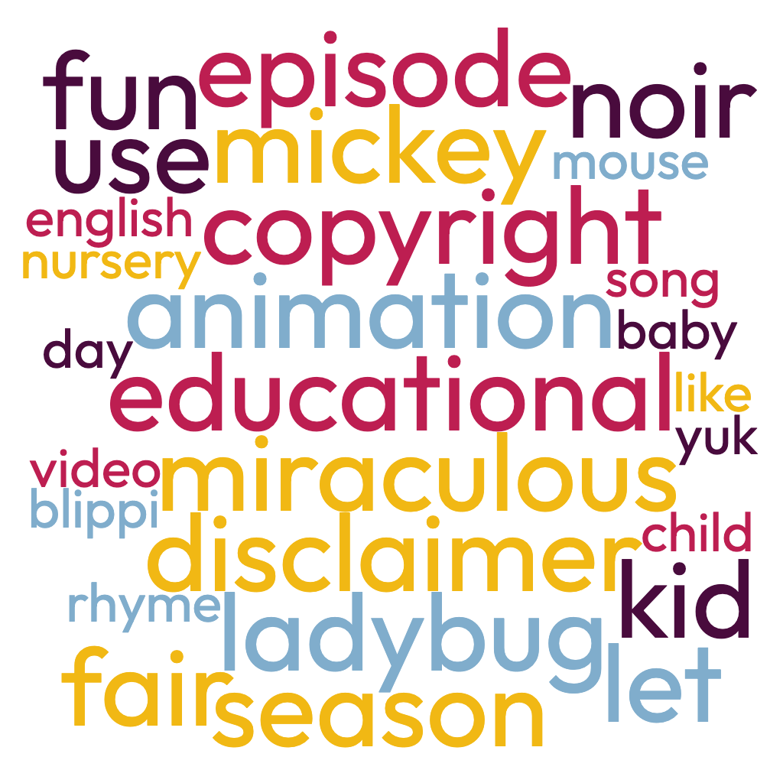
Overview
Main Model
Conclusion
Naïve Bayes Classifier – Top Words for Kids Videos
Notes:
And here’s the training result.
By applying the model for the test videos, I am seeing that 92% of the videos that are actually made for kids are identified correctly.
Also, it is important that the model does not flag too many videos that are not made for kids as kids videos, and the model is successful at flagging only 2% of the non-kids videos as kids videos.

Slide 13
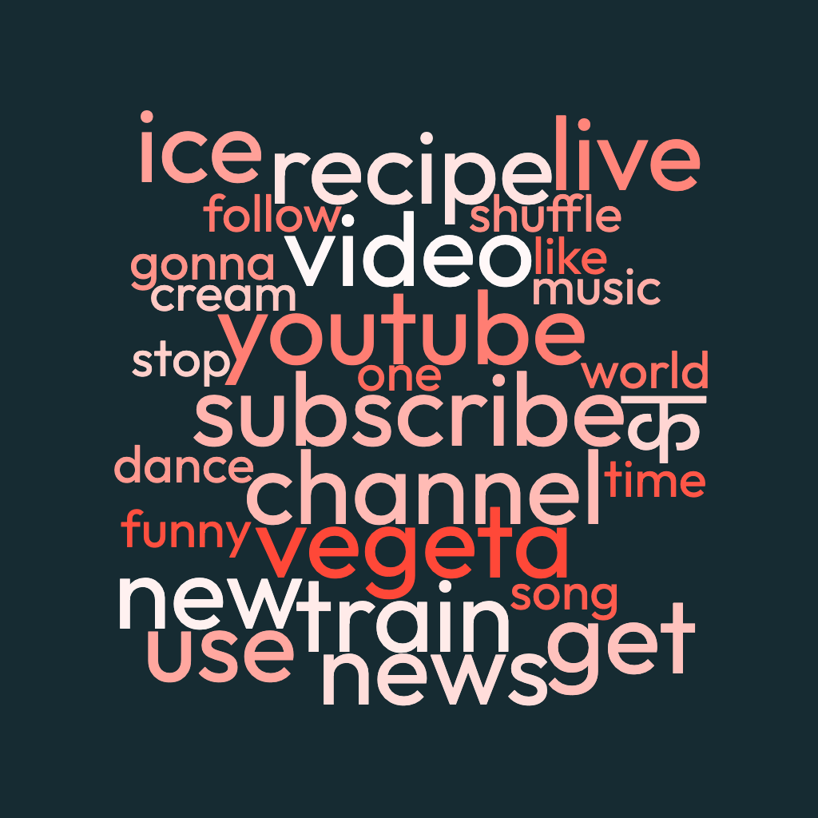
Overview
Main Model
Conclusion
Naïve Bayes Classifier – Top Words for Non-Kids Videos
Notes:
And here’s the training result.
By applying the model for the test videos, I am seeing that 92% of the videos that are actually made for kids are identified correctly.
Also, it is important that the model does not flag too many videos that are not made for kids as kids videos, and the model is successful at flagging only 2% of the non-kids videos as kids videos.

Slide 14
Ii. conclusion

Slide 15
Overview
Main Model
Conclusion
Recommendation & Key Takeaways
Use a Naïve Bayes model
It has high prediction accuracy
Words such as kid, song, and miraculous are highly associated with kids videos
The model can save manual human efforts in identifying videos “made for kids”
Notes:
To conclude, the Naïve Bayes model has prediction accuracy high enough to be used for practical purposes,
and employing such model is going to save a lot of human efforts to review individual videos.

Slide 16
Overview
Main Model
Conclusion
Next Steps
Include more videos for training and testing
Potentially use comments as an additional data point
Notes:
Finally, the following are possible next steps.
First, include more videos for training and testing, so the model can learn from and adjust to a wide variety of videos.
Second, along with the title, description, and tags, we can attempt to use comments as an additional data point. The idea is that comments made for kids videos are likely to be distinct from other videos in terms of the word usage.

Slide 17
Overview
Main Model
Conclusion
Thank You
Sue Lim
Email: sue.suyeonlim@gmail.com
GitHub: https://github.com/suesuyeonlim
LinkedIn: https://www.linkedin.com/in/suelim/

